Slide 1
Final project :
Animal shooting Game
Art & Technology
20191044 김건형

Slide 2

CONTENTS
1. Idea, Concept, Style
2. Flow of the game
3. Details

Slide 3
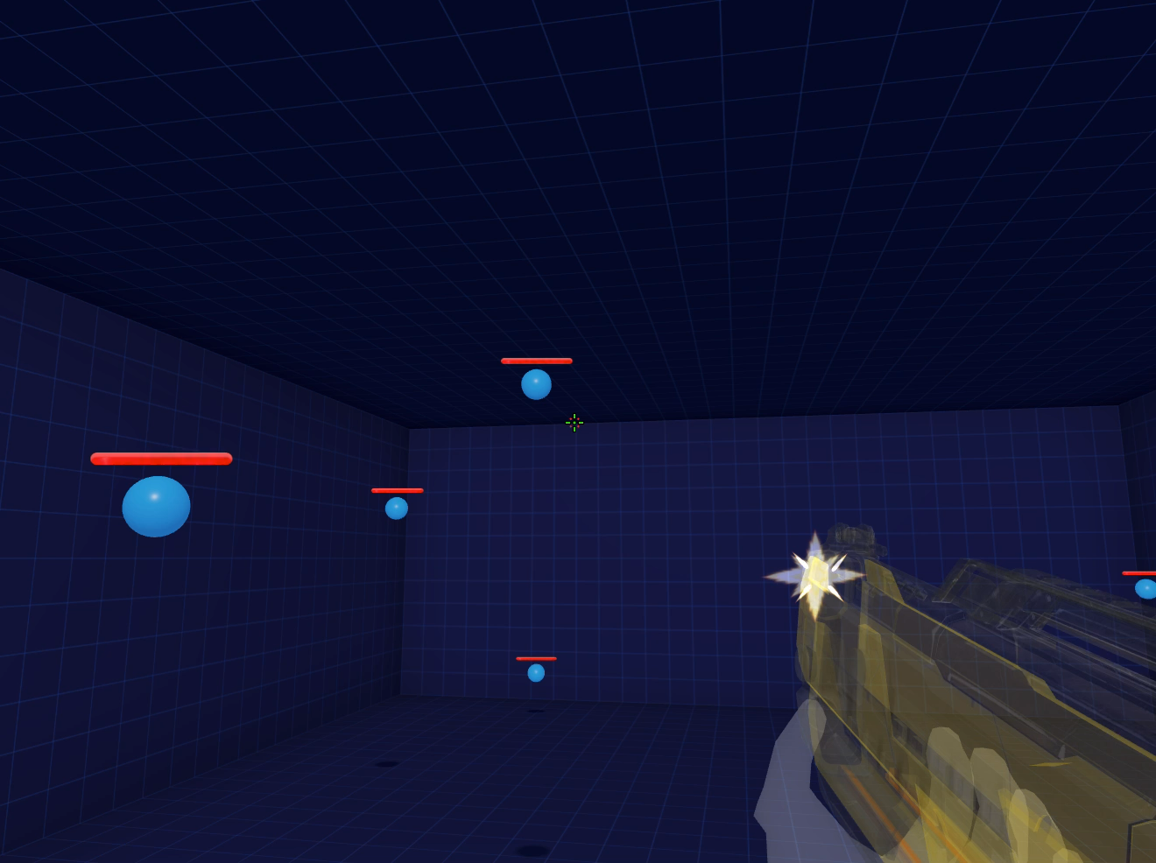
Idea
01
Aiming game

Slide 4
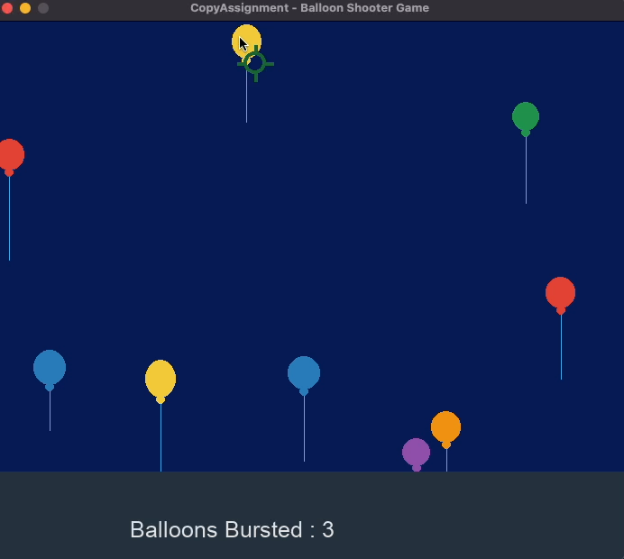
Idea
02
Clinking game

Slide 5
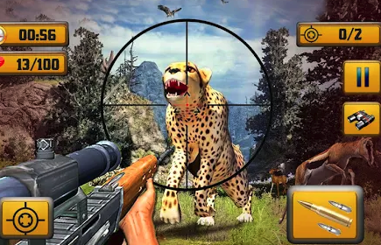
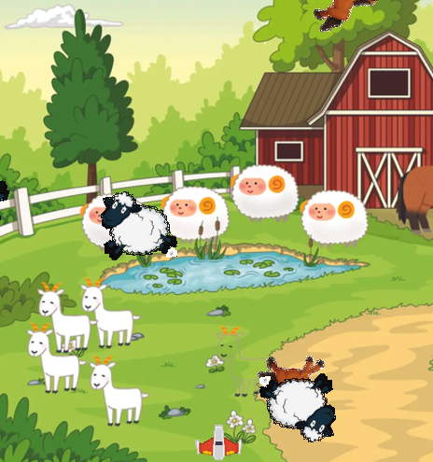
Concept
03
Shooting game + Animal

Slide 6




Flow of the game
04
Game Start
Life : 3
If click on an animal, you earn a score.
else if click on a bomb, you lose a life.
It’s getting harder and harder.
X 100

Slide 7
Flow of the game
05
Details
1. When you click on the animals and the bombs, each
makes a different sound.
2. Life and score are displayed
3. Animals and bombs get more and more and move
faster and more with time.
4. If life = 0, Game over.

Slide 8
THANK YOU!

